Slide 1






Introduction to Robotic Process Auromation
Employee Onboarding Bot
220701223 - Reuben Abraham George
Guided by Dr. N. Duraimurugan
Computer Science & Engineering

Slide 2






Abstract
The "Employee Onboarding Bot" is a Robotic Process Automation (RPA) solution developed using UiPath to streamline the onboarding process for new employees. This bot automates reading data from an Excel file, form filling, and email communication, ensuring efficient and error-free onboarding. The automation reduces the manual workload of HR teams, enhances the accuracy of onboarding procedures, and improves the overall experience for new hires. This project showcases the potential of RPA to simplify repetitive HR tasks, making it a valuable addition to modern business operations.

Slide 3




The Need for the System
Below are the key reasons necessitating the development of the proposed system:
1. Time-Consuming Manual Processes
2. Error-Prone Data Handling
3. Inconsistent Employee Experience
4. Scalability Challenges
5. Compliance and Audit Requirements
6. Cost Efficiency
7. Alignment with Digital Transformation Goals

Slide 4

Advantages of the System
Efficiency: Reduces the time required to complete onboarding tasks, allowing HR teams to onboard more employees in less time.
• Accuracy: Minimizes errors in data entry and document handling through automated validation and logging.
• Consistency: Standardizes onboarding procedures across the organization, ensuring compliance with internal and external requirements.
• Enhanced Employee Experience: Provides new hires with timely and accurate information, fostering a positive impression of the organization..

Slide 5






Literature Survey
Survey 1: Automating Human Resource Functions Using Robotic Process Automation (RPA)
Source: International Journal of Advanced Research in Computer Science, 2020
Summary
Advantages
Disadvantages
The paper presents case studies where RPA reduced onboarding time by up to 60% in multinational corporations. It also examines the scalability of RPA in handling bulk recruitment.
Time Savings
Lower operational costs
Improved data accuracy and compliance through automation
Scalability efficient without additional resources
High upfront costs for RPA software and implementation
Challenges in integrating RPA with legacy HR systems
Dependency on Structured Data

Slide 6
Literature Survey
Survey 2: Enhancing Employee Onboarding through RPA and AI
Source: Journal of Business Process Management, 2021
Summary
Advantages
Disadvantages
It highlights AI-enhanced RPA can address unstructured data and complex decision-making during onboarding. The study also discusses the integration of chatbots for real-time communication with new hires
Enhanced Flexibility
Improved Employee Engagement
AI-powered bots can predict and correct potential errors in data validation
Higher implementation complexity due to AI-RPA integration.
Maintenance Challenges
More expensive compared to standard RPA solutions due to AI integration and maintenance.

Slide 7




Objective & Problem Statement
Objective
The primary goal is to revolutionize the traditional onboarding process by automating key activities.
To ensure a seamless and efficient onboarding experience, both for HR professionals and new employees
Problem Statement
Traditional employee onboarding processes are manual, making it challenging for HR teams to handle large-scale recruitment

Slide 8

System Requirements
Hardware Requirements
Software Requirements
Processor: Intel i5 or higher
RAM: Minimum 8 GB (16 GB for smoother performance)
Storage: At least 20 GB of free disk space
RPA Platform: UiPath Studio 2023.x or higher
Supporting Applications: Microsoft Excel
Email Client or SMTP Server
Network Requirements
Additional Requirements
SMTP Configuration: SMTP server credentials
Database/HRMS Access: for integrating with organizational HR systems.
Access to HR folders or directories containing onboarding documents.
Folder paths for input files and logs preconfigured.

Slide 9
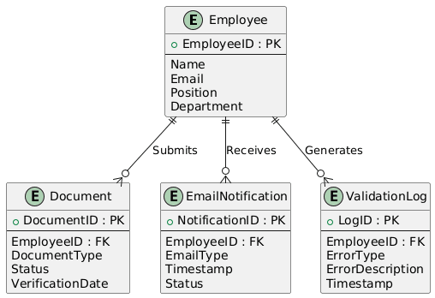


ER Diagram

Slide 10



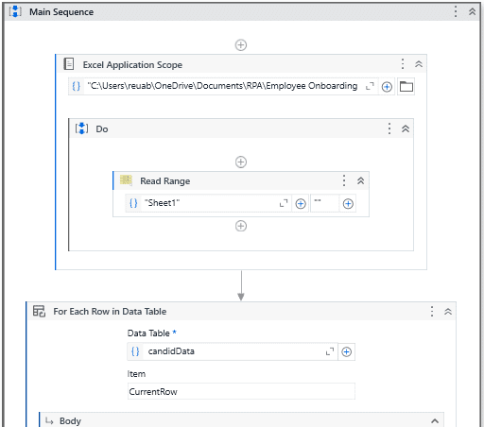
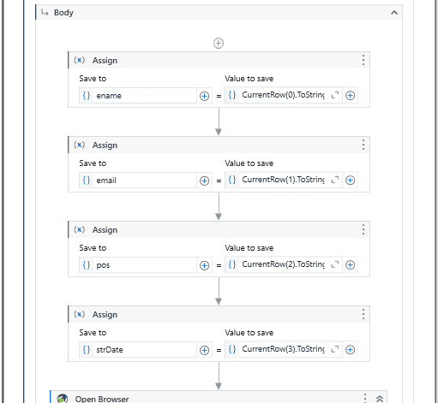


Process Design
Our workspaces are designed with your well-being in mind, featuring ergonomic furniture to support comfort and productivity.

Slide 11
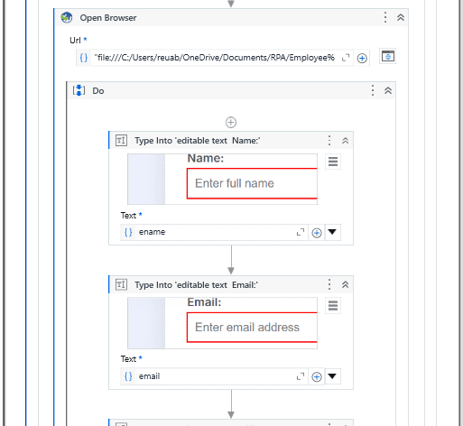
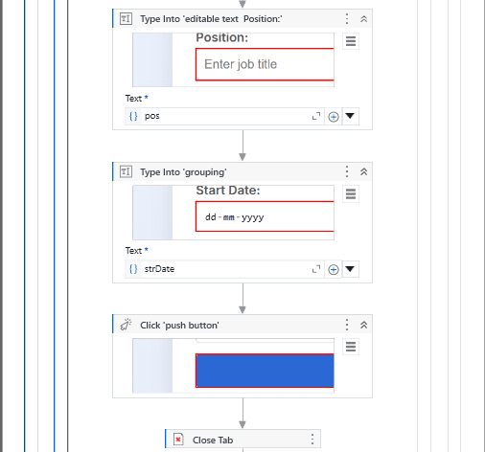
Process Design
Our workspaces are designed with your well-being in mind, featuring ergonomic furniture to support comfort and productivity.

Slide 12
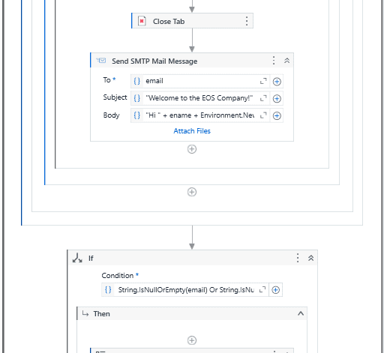
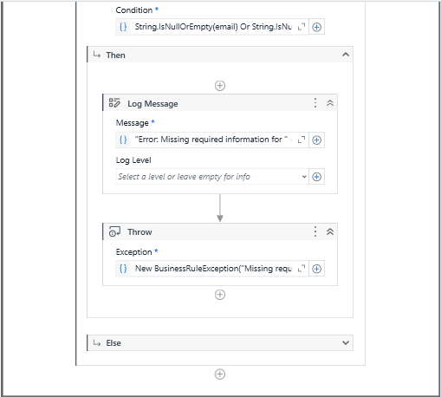
Process Design
Our workspaces are designed with your well-being in mind, featuring ergonomic furniture to support comfort and productivity.

Slide 13
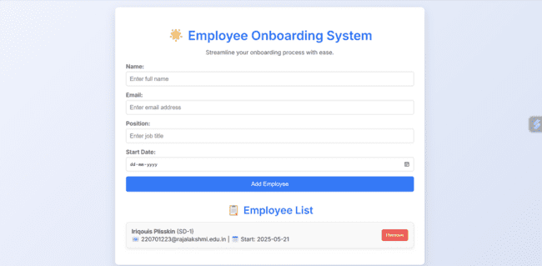
Implementation
The content from each Excel document is Typed Into the fields of the HR System content

Slide 14
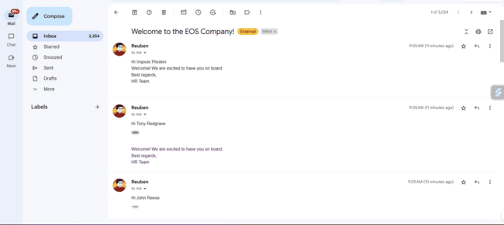
Implementation
Automated Email Notification Screenshot

Slide 15



FUTURE ENHANCEMENTS
Integration with Artificial Intelligence for Advanced Validation:
The bot can be enhanced by incorporating AI and machine learning models to handle complex scenarios in data validation and document verification. AI could enable
Multilingual and Cloud-Based Deployment
To cater to global organizations with diverse workforces, the bot can be upgraded to support multiple languages for data input, email communication, and reporting.

Slide 16





References
Automating Human Resource Functions: A Robotic Process Automation Perspective - International Journal of Advanced Research in Computer Science
Robotic Process Automation: A Guide for HR Professionals by James Manos and Sarah Riggs
The Role of RPA in Enhancing Employee Experience During Onboarding - Journal of Business Process Management

Slide 17




Conclusions
In summary, the "Employee Onboarding Bot" effectively addresses traditional onboarding inefficiencies, enabling organizations to modernize their processes and focus on strategic HR initiatives. As organizations embrace digital transformation, such automation tools will play a pivotal role in creating efficient, scalable, and employee-friendly systems.

Slide 18





Thank you

